Slide 1

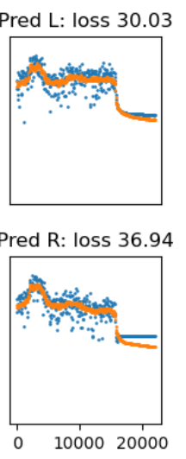
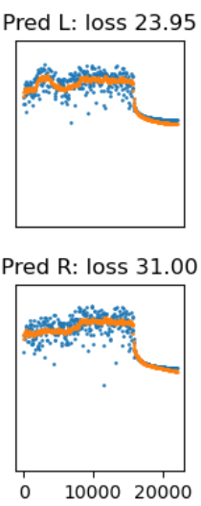
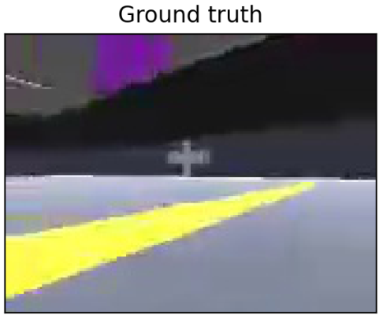
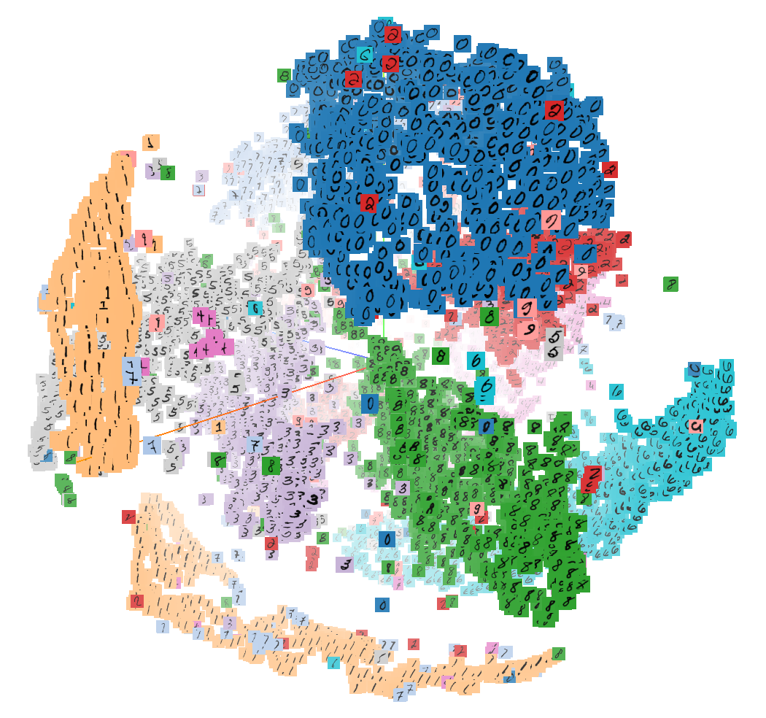
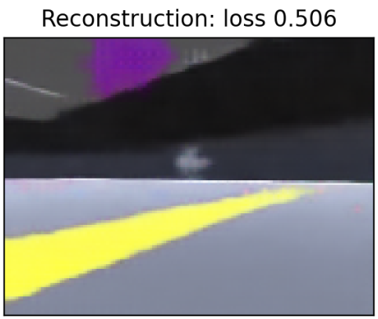
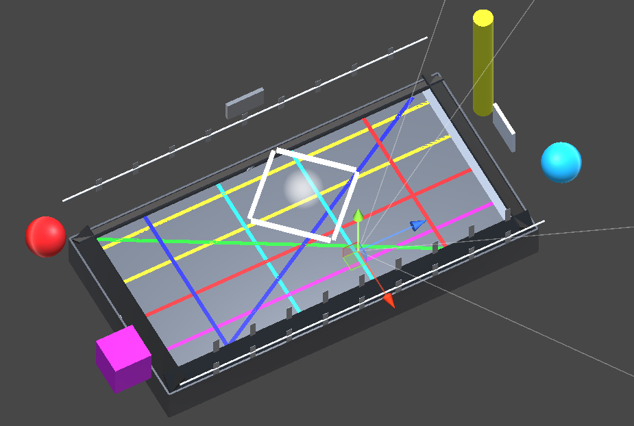
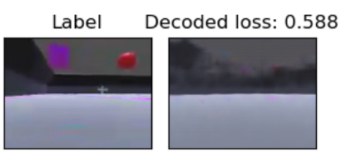
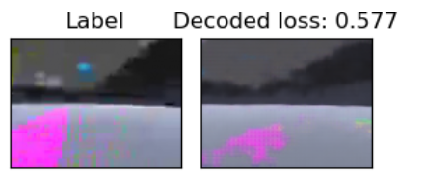
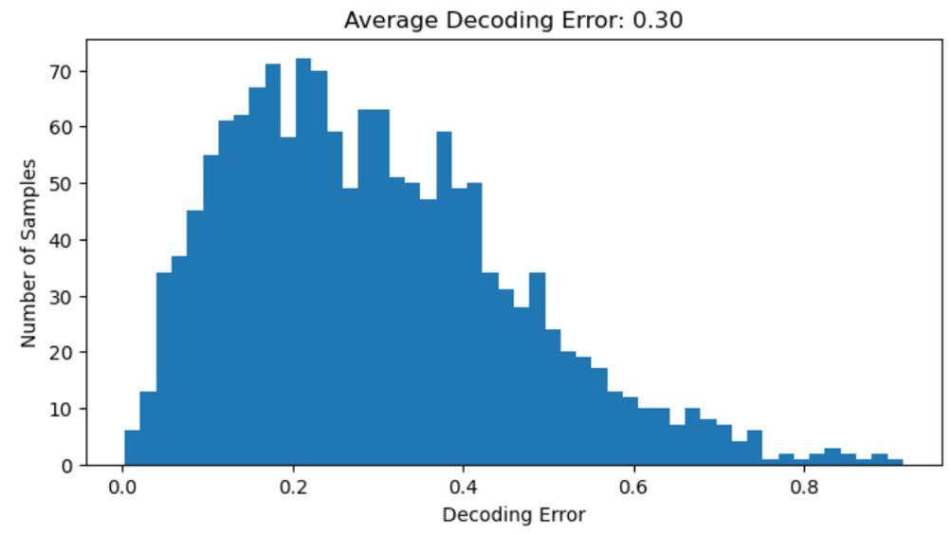
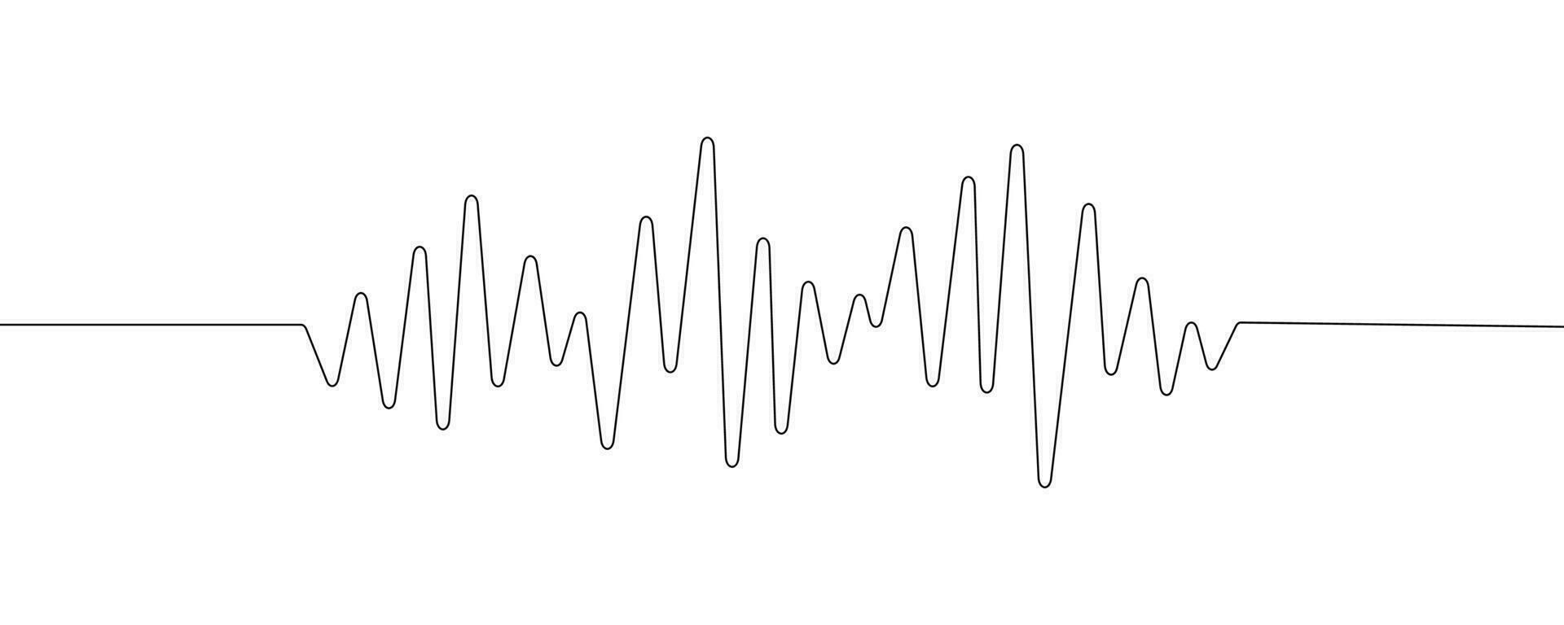
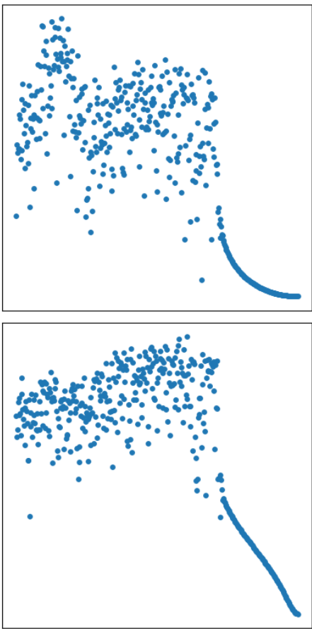
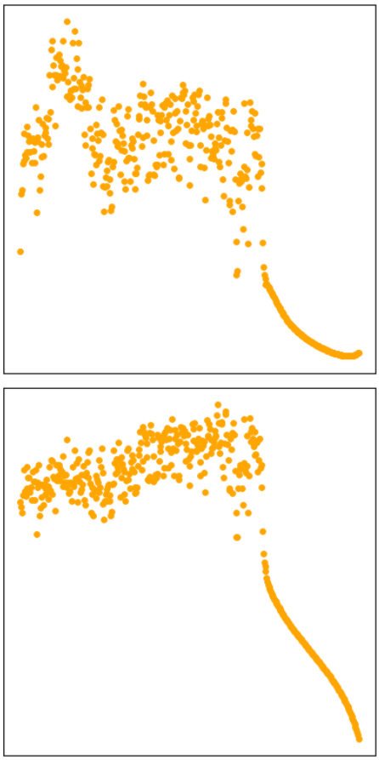
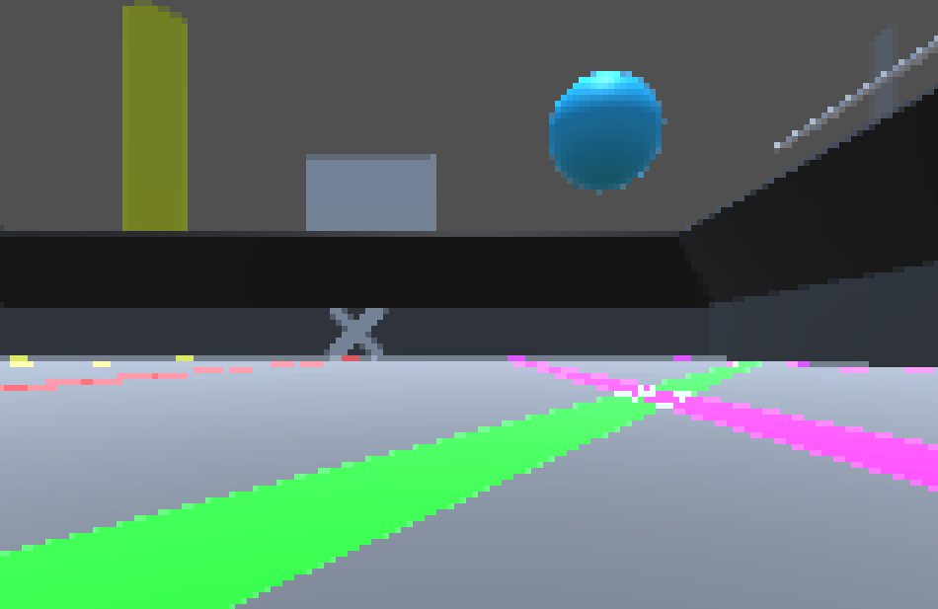
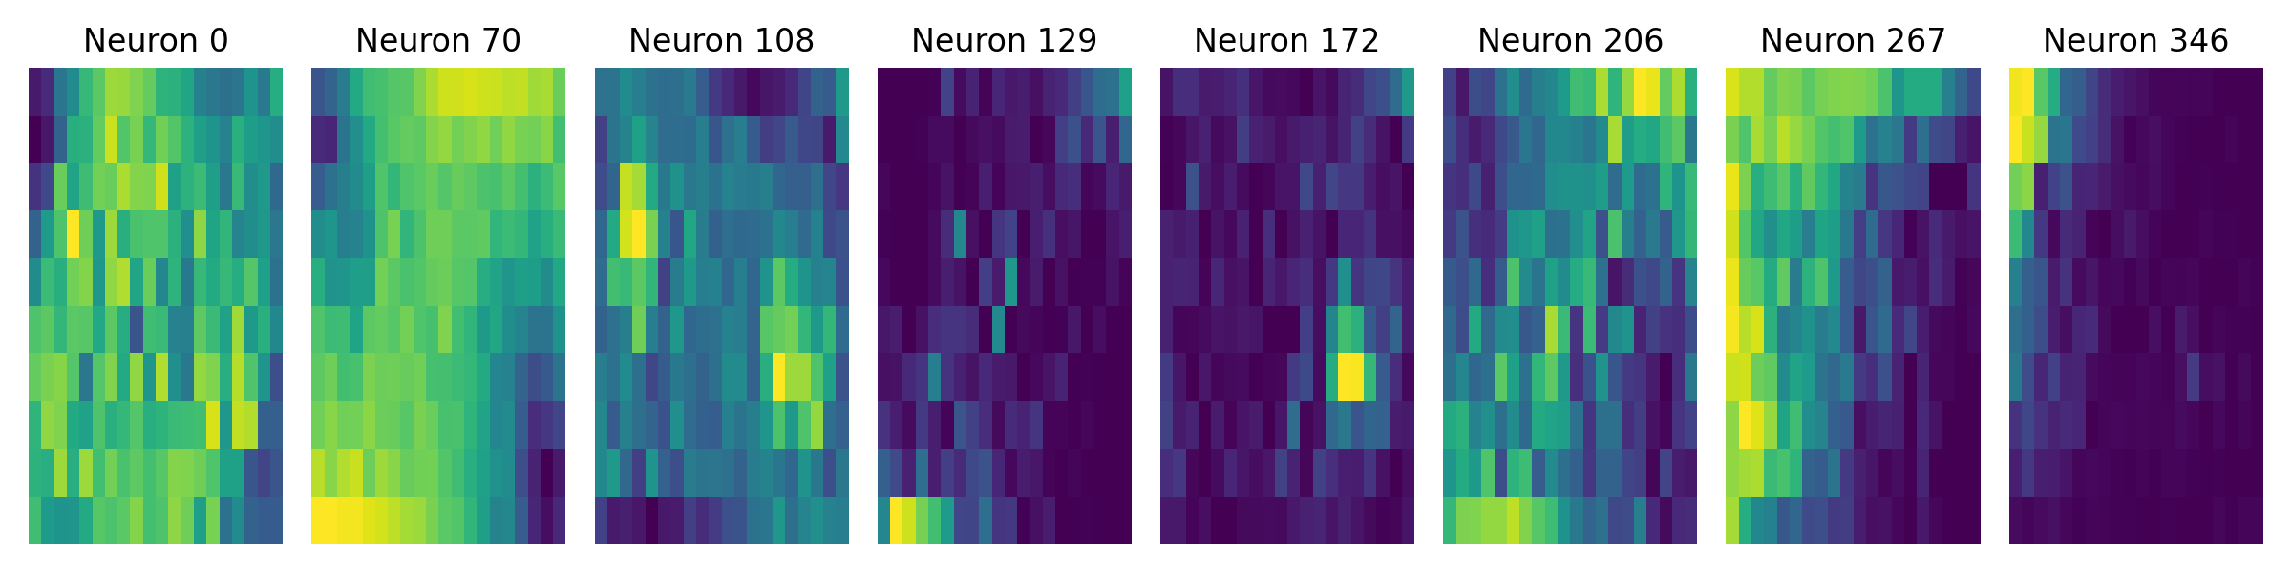
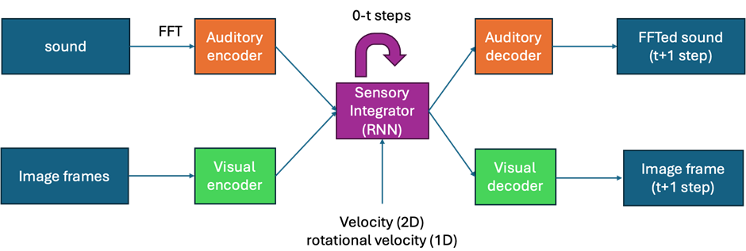
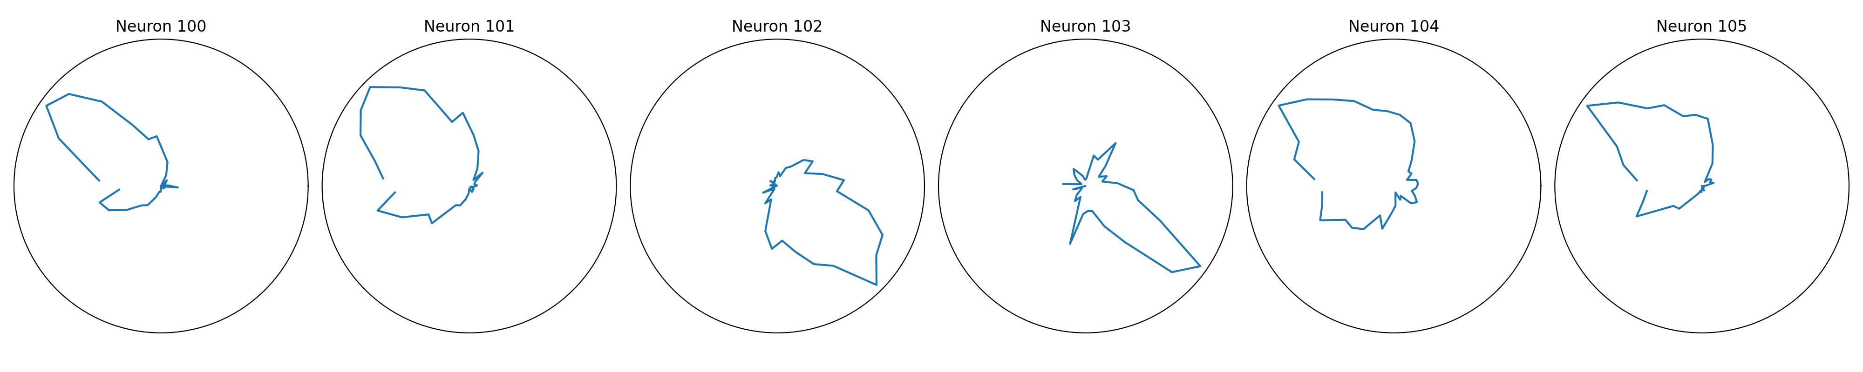
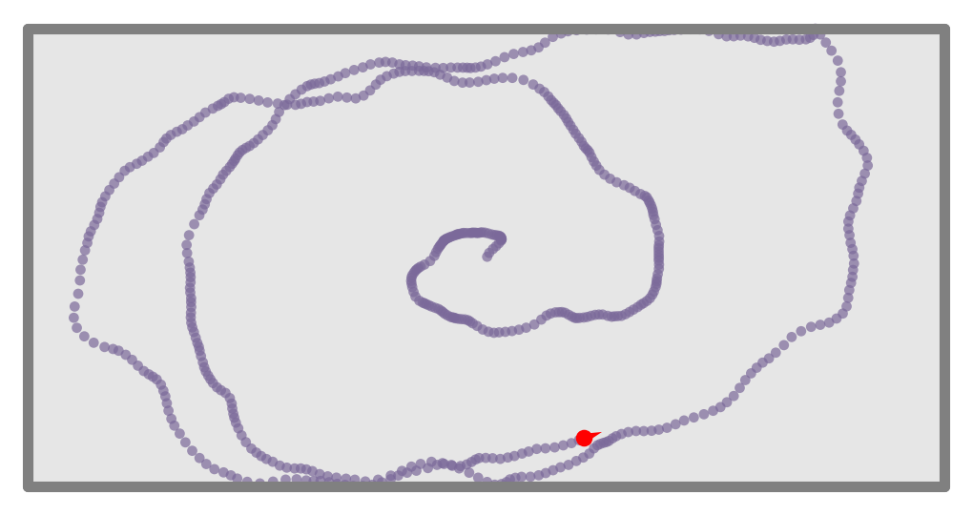
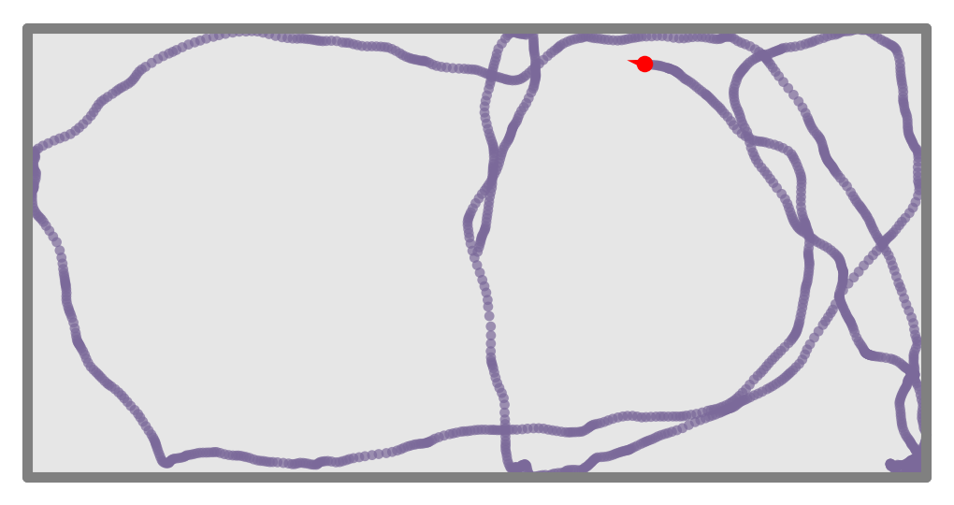



A Deep-Network Exploration of Sensory Fusion in the Ferret Brain
S.Liu^{1*}; J.Bizley²; & C.Barry¹
¹ UCL Dept of Cell & Developmental Biology. ² UCL Ear Institute.
* Equal contribution. Correspondence to sihao.liu.18@ucl.ac.uk
Introduction
The brain receives multi-model sensory information from the world, such as vision and sound, that are self-centred (egocentric). Neurons in the brain demonstrate world-centred (allocentric) cognitive maps. It is unclear how the brain transforms between the reference frames – in this project, we simulate sensory data of a ferret in a virtual reality (VR) based on real world arena and build machine learning (ML) models to test this theory.
Sensory Modules
Results
1. Visual Module. We used a paired convolutional neural network autoencoder to compress visual information to 200-dimensions and trained to reconstruct the image.
Predictive Performance. By using the sensory integrator’s output to decode the next step, the decoder was able to capture the majority of sensory cues -- with the exception of some landmarks. The predictive performance is statistically significantly better than simply predicting the last step as a baseline.
Virtual Reality
We constructed a rectangular virtual arena with multiple visual landmarks on walls, ground and in the horizon as well as two speakers located at two corners looping high- and low-frequency sound signals, using Unity 3D game engine.
160 x 120 x 3
CNN
encoder
200-dim
emb
CNN
decoder
160 x 120 x 3
2. Auditory Module. We used a paired feedforward neural network to process auditory information. Fast Fourier transform is first performed on the audio segment. We then used a two-layer encoder to compress auditory information into a 200-dimensional encoding, followed by another one to reconstruct the signal.
Positional Decoding. Linear decoder using RNN hidden state decoded the position with average error 0.296, with 80% error lower than 0.4. Random prediction yields 0.833.
L
L
A camera is programmed to follow the virtual ferret agent to capture visual information (see video).
We implemented and programmed dual channel microphone such that it receives 3D spatialised sound under a head-related transfer function.
FFT
R
R
200-dim
emb
Spatial Tuning. Tuning curve similar to Place Cells, Border Cells and Head Direction Cells in the brain are found in the hidden units of the sensory integrator.
Freq vs dB
Freq vs dB
3. Sensory Integrator. A single-layer recurrent neural network (RNN) with additional biological constraints receives multiple steps of sensory embeddings processed by the pre-trained visual and auditory encoders, as well as instantaneous motion signals (velocity and rotational velocity). The output latent embedding from the sensory integrator is casted through the decoders to predict the sensory signal of the next step.
Motion Model
Using a software toolkit, we generated an hour-long motion trajectory comprising of circular and Brownian motions by modelling the velocity of the ferret as an Ornstein-Uhlenbeck process and separated into training and test sets:
Conclusions
We constructed a VR environment, paired with a motion model that serves as a test bed for a wide range of sensory simulation experiments.
We show that deep neural networks are suitable for integrating multiple sensory modalities for future sensory predictions.
Spatially tuned patterns similar to cells found in the brain can be extracted from the hidden states of these networks.
Circular with stochasticity
Brownian motion
Discrete-time recurrent neural network defined by
We then programmed the virtual ferret agent to follow this trajectory. With a motion model, we have full access to the agent’s velocity, rotational velocity and head direction data.
(Hidden state)
(Output)
¹References TBC.

